Slide 1
GROUPS & TEAMS
Expected learning outcome-
be able to analyze groups and teams and their functioning.

Slide 2
Group and Team
A group is a collection of individuals who coordinate their individual efforts to accomplish a task.
On the other hand, a team is a group of people who share a common team purpose and a number of challenging goals.

Slide 3
TEAM CHARACTERISTICS
□Clarity of goals and objectives: The team members should be very much clear about the goals and objectives of the team as these will help them to have better clarity about the vision and purpose of the team.
□Communication: Two way and regular communication is very much crucial for the success of the teams as without communication no problem can be solved.
□Clarity of roles: Each member in team has a clear
understanding of the role to be played and tasks to be carried out by him/her.

Slide 4
…………….
□Suitable and situational leadership: Every team has a formal leader, however, the unique characteristic of team is that the role of a leader can be performed by any other team member if the circumstance so demands.
□Participation:
Opinions are valued and hence,
leaders create a climate of participation.
□Open discussion and conflict: Sharing viewpoints and dealing with disagreements positively is another characteristic of team.

Slide 5
……………..
□Valued diversity: Diversities in skills, attitudes and values are valued in teams keeping in mind the cross functional requirements in problem solving.
□ Continuous self assessment: While performing the assigned task, the teams stops in between to assess how well it is performing.

Slide 6
Advantages of teamwork
□Effective utilization of resources
□Better decisions
□Motivation
□Self-development and growth
□Organizational enhancement

Slide 7
Disadvantages of Teamwork
□ Some people do not enjoy working in team
□ Conflicts may arise among the team members
□ Decision making may become time consuming
□ Groupthink can kill the creativity of team members
□ Replacement becomes awkward if the person has stayed in the team for longer period

Slide 8
Types of teams
9

Slide 9
Nature of Management
✔ Self Managed Teams
✔ Supervised Teams

Slide 10
Period of Existence
✔ Permanent Teams
✔ Temporary Teams

Slide 11
Nature of Work
Work Teams
Management Teams
Taskforce Teams
Committees
Virtual Teams
Cross Functional Teams

Slide 12
Self-managed teams- It is that team where the responsibility of operating lies on the team itself to achieve the target.
Supervised teams- Unlike the self-managed teams supervised teams are managed by a leader or a supervisor.
Permanent teams- Functional department like HR, Finance, Operations in Organizations are the examples of permanent teams.

Slide 13
Temporary teams- These types of teams are generally formed to assist the permanent teams. These teams exists for a short period and dissolves once the tasks are over.
Works teams- These work teams are pre-dominantly concerned with the work done by the organizations like developing new products & services and so on.

Slide 14
Management teams- These teams consists of individuals of managerial positions. These teams are permanent in nature. Employees who are on Board of Management of any company may comprise the management team of the organization.
Task force-The organizations may sometimes form some special teams in order to deal with a particular situation or to solve a specific problem such teams are called as task force teams.

Slide 15
Committees- Committees are formed to take care of a particular task or project. For example, cultural committee, placement committee etc.
Virtual teams- The teams that do not meet physically in a meeting room but are connected via a network are called as virtual teams.

Slide 16
Cross Functional teams- a cross functional team comprises of individuals with different functional proficiency like marketing, HR, finance etc., working towards a common goal.

Slide 17
MCQs
Teams occur when a number of people have ………………and recognize that their personal success is dependent on the success of others.
a. A shared work environment
b. The same manager
c. A common goal
d. Similar jobs

Slide 18
2
A virtual team is a collection of people who are _________________ separated but still __________________ together closely.
a. Geographically; decide
b. Geographically; work
c. Temporally; work
d. Physically; think

Slide 19
Recap quiz
When the goals are set and courses of actions are decided by team members themselves it is called as-
Supervised teams
Self-managed teams
Work teams
Task force teams

Slide 20
Reasons for Team Failure
Unclear Role
Time Management
Impact of changing market scenario
Ego
Lack of planning
2

Slide 21
How to create effective teams
Define the purpose clearly
Select members having complementary skills
Identifying task and assigning deadline
Expected output and the standard should be defined
Regular meetings should be conducted
Recognize and reward both individual and team performance
Continuous monitoring

Slide 22
PROCESS OF TEAMWORK
Transition process: This process deals with formation of team, mission, vision, goals and strategies.
Action process: This is the phase when the team performs its task or in other words executes the projects it is allocated.
Interpersonal relations: This phase focuses on conflict management, motivation and control.

Slide 23
Group
A collection of people who interact with one another, accept rights and obligations as a members and who share a common identity. e.g., Presentation group

Slide 24
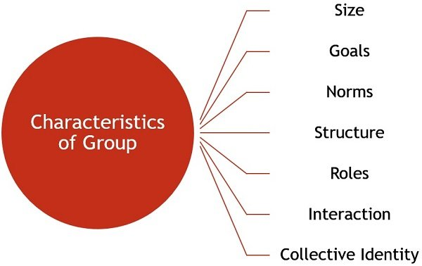
Characteristics of Group

Slide 25
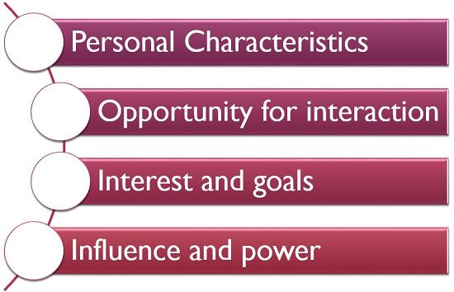
Reasons for Group formation

Slide 26
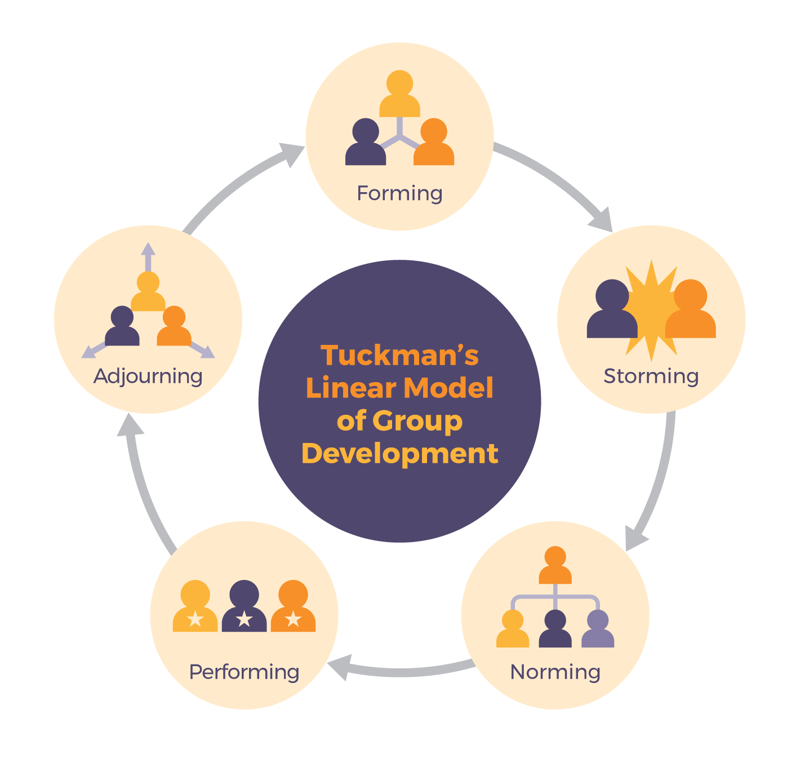
Stages of Group Development

Slide 27
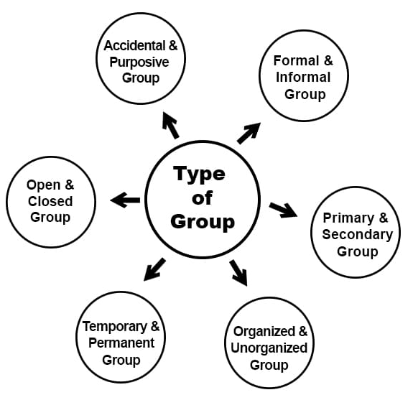
Types of groups

Slide 28
Formal Group vs Informal Group
Basis for Comparison | Formal Group | Informal Group
Meaning | Groups created by the organization, to accomplish a specific task, are known as Formal Groups. | Groups created by the employees themselves, for their own sake are known as Informal Groups.
Formation | Deliberately. | Voluntarily
Size | Large. | Comparatively small.
Life | It depends on the type of group. | It depends on the members.
Structure | Well Defined. | Not well defined.
The importance is given to | Position. | Person.
Relationship | Professional. | Personal.
Communication | Moves in a defined direction. | Stretches in all the directions.

Slide 29
Cohesive Group
Cohesion can be defined as the tendency for a group to be in unity while working towards a goal or to satisfy the emotional needs of its members.

Slide 30
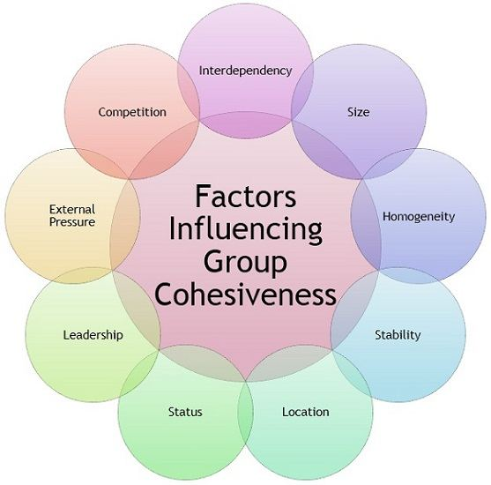
Factors influencing Group Cohesiveness

Slide 31
Skills for a Healthy group
To work together successfully, group members must demonstrate a sense of cohesion.
Cohesion emerges as group members exhibit the following skills:
Openness
Trust and Self-Disclosure
Support
Respect
Individual Responsibility and Accountability
Constructive Feedback

Slide 32

Why individual Join in Group?

Slide 33
Deindividuation
The process whereby the presence of others lead to individuals losing their sense of personal identity.

Slide 34
Groupthink
The tendency whereby a group reaches a decision by trying to minimize conflict, neglecting to critically test and evaluate ideas.

Slide 35
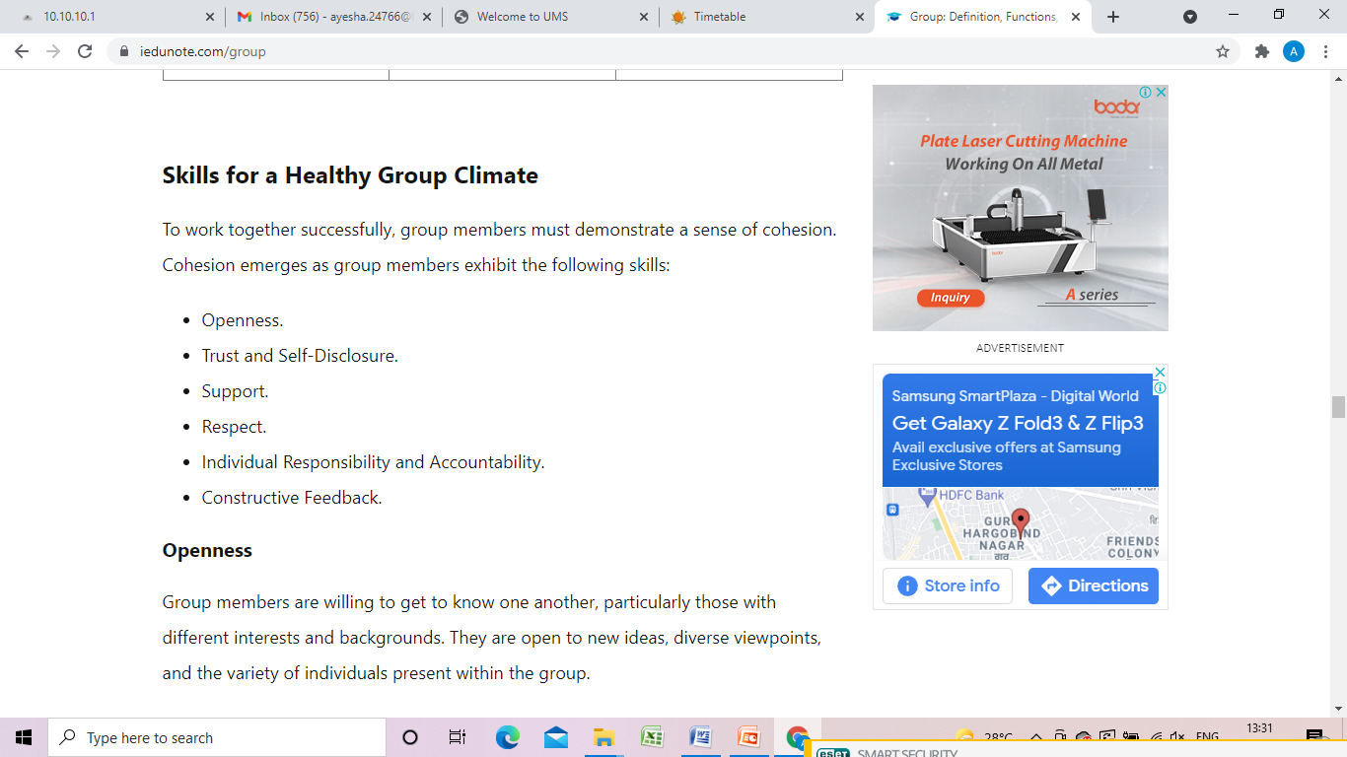

Slide 36
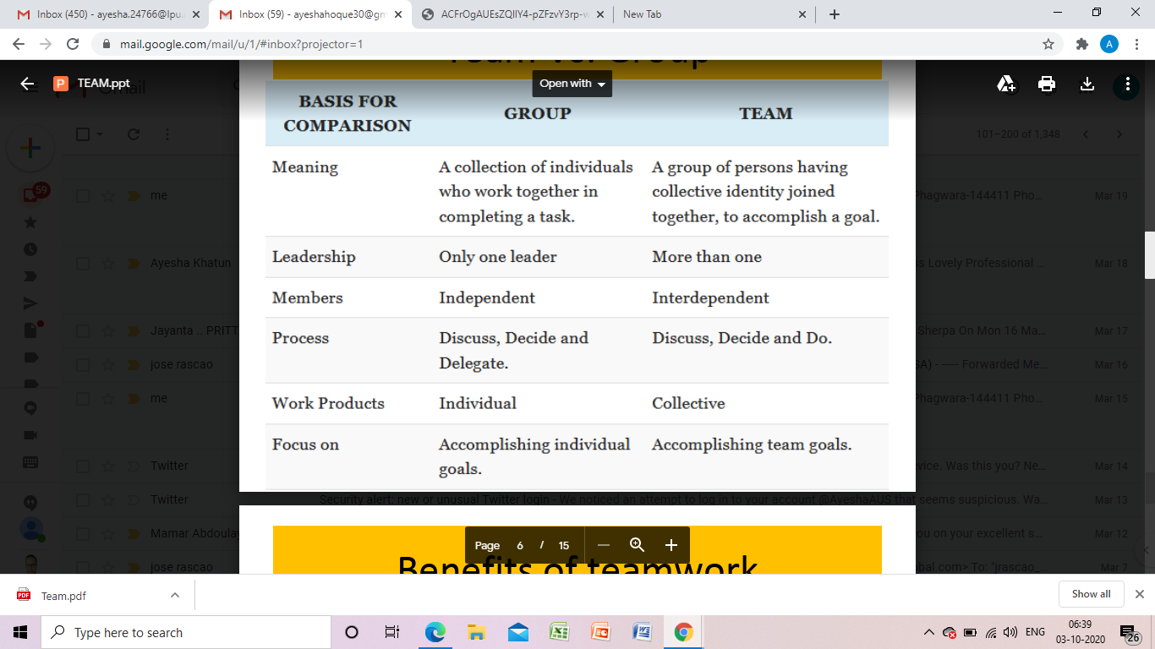
Team Vs. Group

Slide 37
MCQs
According to Tuckman (1965), which of the following is NOT a stage of the life cycle of a group:
a. performing
b. norming
c. reforming
d. storming

Slide 38
2
What is the term Tuckman uses for reaching consensus as a group?
a) Storming
b) Performing
c) Forming
d) Norming

